Slide 1
Clean Energy Transition, Scarcity and Urban Mining
presented by Clara Carrera
INSEAD, Technology and Operations Management
with Serasu Duran¹, Atalay Atasu² and Luk N. Van Wassenhove²
¹University of Calgary, Haskayne School of Business
²INSEAD, Technology and Operations Management
Notes:
This paper is about a roadblock/challenge to the energy transition which is the scarcity of the materials used to build clean energy technologies, and some ideas on how industry/policymakers can remediate it

Slide 2
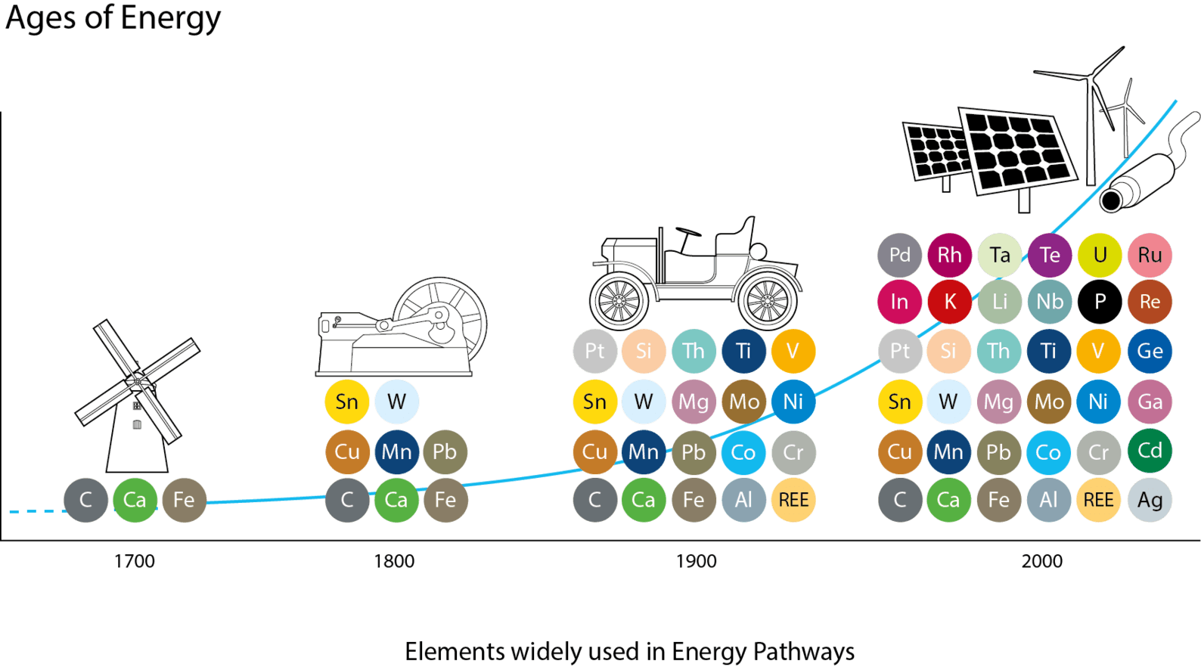
The low carbon economy is a minerals economy
Notes:
Increasingly complex energy technologies use an increasingly wide range of metals in large quantities
Clean energy technologies use large amounts of minerals, such as rare earth metals for wind turbines, silver&copper for solar panels and lithium&cobalt for batteries
Challenge with low carbon energy is materials
Not only increasing quantities, but also wider range because of the increasingly complex products
Looking back, humanity is using increasingly complex products and materials to create and harness energy
Mills – wood, lime, iron
Steam machine – fuelled by coal– copper, tin, lead,…
Cars – Fuelled by oil – wider range of metals
New energy products use the widest range of products in the highest quantities than ever in history
Wind turbines – 1 ton of Rare Earth Metals in each turbine
Solar panels – Silicon, Silver, Copper – 20g/solar panels, 1ton/MW,
Batteries (EV cars) – Lithium, Cobalt, Nickel, Copper – 8kg of lithium, 14kg of cobalt and 20kg of manganese in an EV battery

Slide 3
Upon the clean energy transition…
…limited & concentrated supply may not catch up with demand
Energy installations, GW
Copper
Lithium
Cobalt
Expected demand vs supply
2020
2030
2020
2030
2020
2030
Mine production
Net Zero Scenario demand
2021
2030
2021
2030
2021
2030
Supply concentration
(Extraction & Processing)
Today
28%
52%
70%
Net Zero Scenario – Paris Agreement
40%
58%
65%
Notes:
Additional mining won’t solve the problem: 15+ years to open a mine, expected mine production won’t catch up by 2030. Plus, social opposition (France, Serbia, etc)
Supply is very concentrated in a few countries (both extraction and processing), which makes supply volatile to geopolitical tensions
Beyond physical limits -> “Geopolitical scarcity”

Slide 4
How can we maintain the clean energy transition in the face of scarcity?
No investment
Investment
Benchmark
Material Reduction
Urban Mining
Secondary
Supply
Systemic Leakage
Waste
Waste
Waste
Energy efficiency
Notes:
Let me use solar panels as a running example
1 – Do nothing, continue to mine, continue to decommission products at EOL (today, the simplified recycling technologies which are used recover at best low-value materials)
2 – Invest in:
- MR
-UM -> Requires investments to build complex recycling processes and reverse logistics
Which is the better approach from a business/policy point of view? Where are the misalignments?

Slide 5
We model a monopolist producer and check alignment with regulator objectives
Maximize clean energy generation
Maximize expected profits
Profit = Revenues - Costs
Maintain industry production and profitability
Decisions:
Virgin Material purchases
Investment decisions (Y/N + quantity)
Decisions aligned? Where to intervene?
Notes:
Which is the better approach from a business/policy point of view? Where are the misalignments?
For the sake of time, I have refrained from putting equations into the presentation, but all of the details are in the paper available online

Slide 6
Our model
Producer contracts q units
Market baseline revealed
Producer pays price
Scarcity
Price increases with consumption
Material Costs
Volatility
Random component
Time
1 unit of critical material
1 clean tech product
1 MWh of clean energy
Benchmark
Material efficiency
Energy conversion
Material Reduction
Revenues
Urban Mining
Notes:
Scarcity captured by explicitely modelling the price of the critical raw material as increasing with the quantity consumed, following the literature
Virgin material price is also subject to volatility, capturing other market-related effects
The critical material is a commodity traded under a index-linked contract, meaning that the producer chooses the purchase quantity ahead of time but the price paid for the commodity is revealed later. Thus, the producer risks incurring negative profits.
Revenues are proportional to energy generated, not units of critical material
Benchmark – Scale everything to one
MR – While the same amount of critical material will produce MORE clean technology products, efficiency trade-offs mean that the energy generated will not be as high
UM – Material-to-energy efficiency is the same, but additional supply from EOL products
Main driver of costs
Scarcity increases prices: Hotelling (1931)
Stochasticity: Krautkraemer (1998)

Slide 7
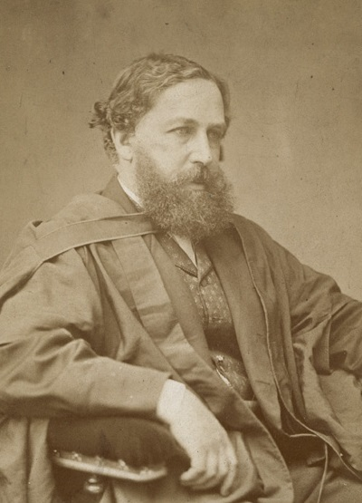
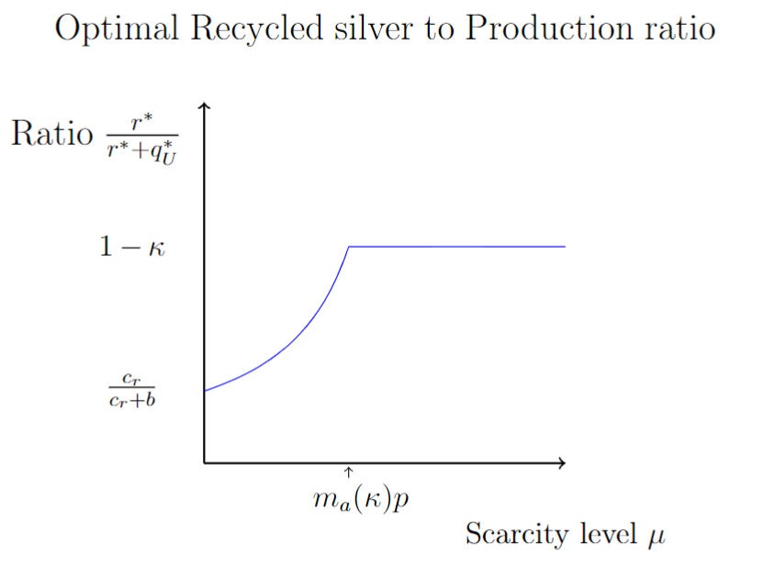
Results
Material reduction
Urban mining
Maximize clean energy generation
Material Reduction ≿ Benchmark
Urban mining ≿ Benchmark
Recycled %
But! Systemic leakage
Virgin material consumption
Jevons’ paradox (1865)
Scarcity level
Maintain industry production and profitability
Material Reduction
$$≤$$
Benchmark
$$≤$$
Urban mining
Notes:
Begin recap: 1- Scarcity is coming at us, 2- Discussed options, 3- Model set-up 4-Results let’s go
End recap: Other words: both strategies are effective, but for different reasons: MR increases consumption because on expectation margins are larger, which leads to higher virgin consumption but then more vulnerability/dependency to stochasticity in prices. On the other hand, recycling the materials can be seen as a real option because the producer is able to hedge between the risky virgin material and a reliable supply of secondary material (as long as access is available)
“Can see recycling as a real option”
Compare the outcomes of the two investment strategies with benchmark (where the producer is choosing optimally) on the two dimentions that the policymaker cares about
Recbound effects occur when a technological progress increases the efficiency of use of a resource, which reduces its cost of usage, which increases the demand and thus the overall resource use
What about MR vs UM? Which one is preferrable?

Slide 8
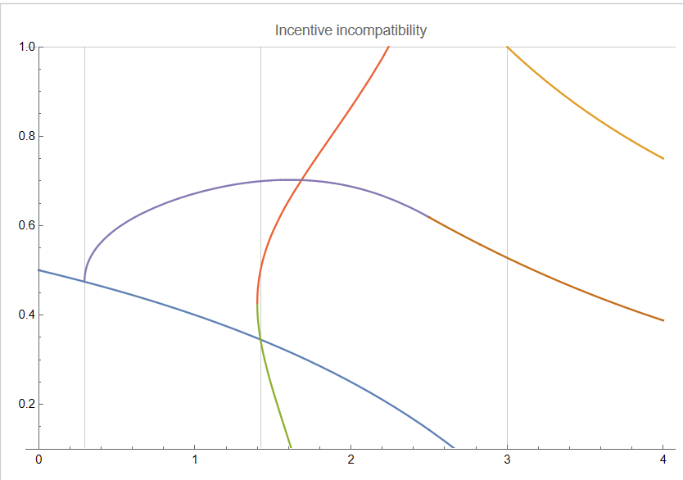
What should policymakers do?
Producer strategy by scarcity and systemic leakage
UM misalignment
Material
Reduction Alignment
Material Reduction
MR misalignment
Benchmark
Subsidize Urban Mining/ Material Reduction costs?
Systemic leakage
Improve access to EOL products?
Urban Mining
MR Preferred by Policymaker
UM Preferred by Policymaker
Scarcity level
Notes:
As opposed to telling you when this or that happens, let me tell you what are the practical implications of this plot.
Scientific community warning about the imbalance of supply and demand -> Need to prepare for much higher scarcity
Europ Comission, IEA talking about MR
Should be focusing on UM -> Better in high scarcity, also better for security of supply -> SUPER expensive + Requires access -> Should be sponsoring collection infrastructure

Slide 9
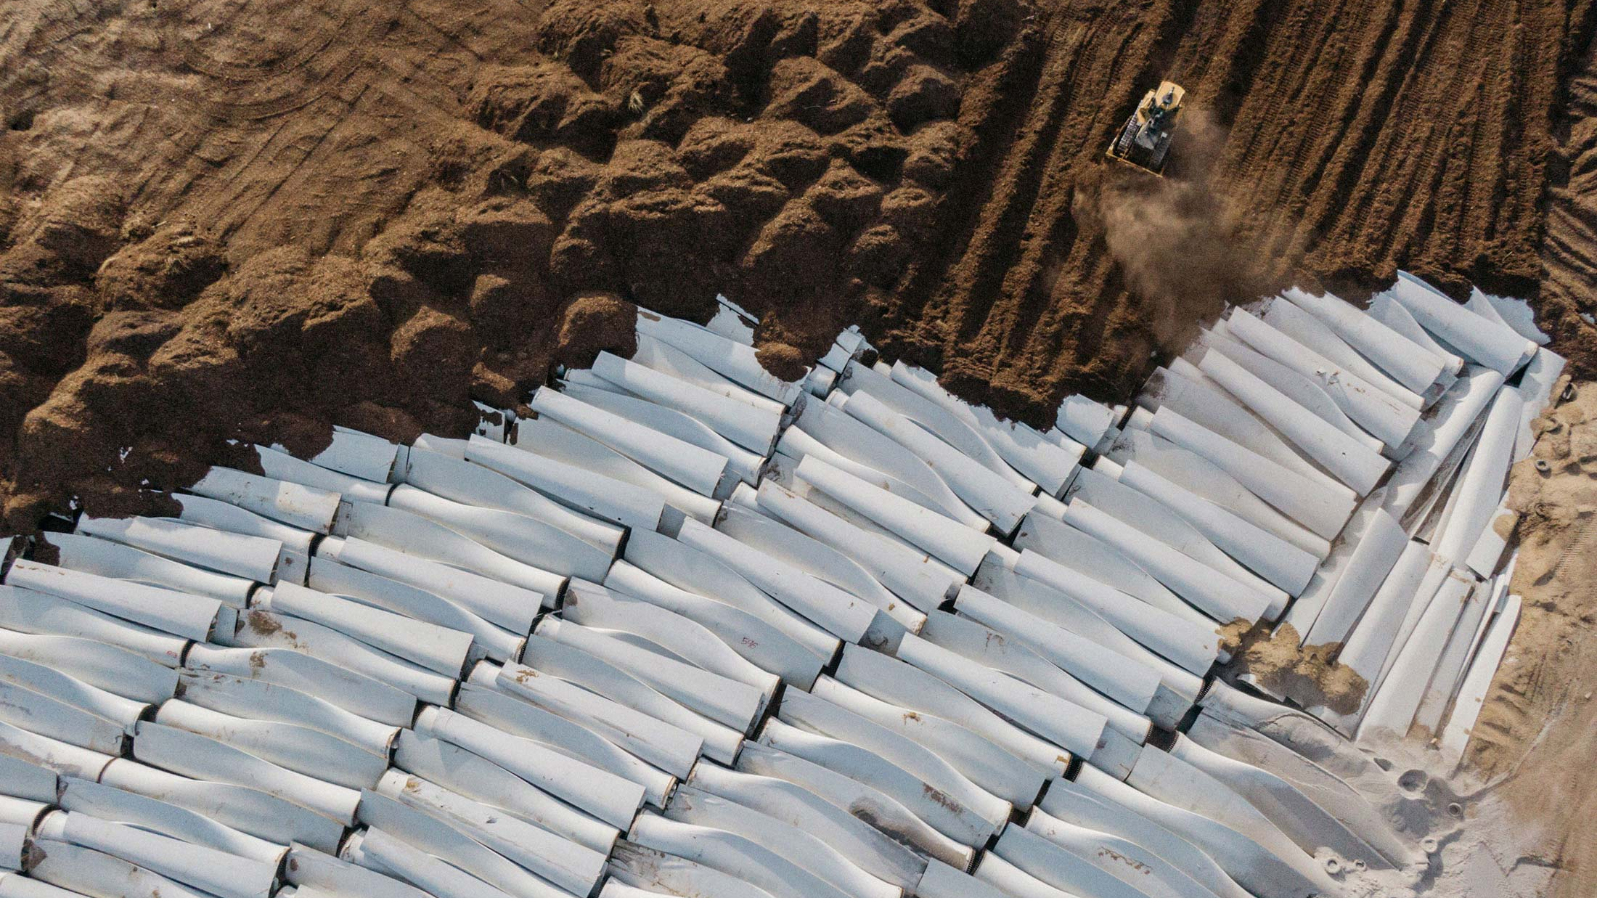
Concluding remarks
Clara Carrera
clara.carrera@insead.edu
Notes:
Scientific community warning about critical materials as a roadblock. This problem has not been seriously considered in OM, clearly critical with strategic impact (policymaker, env perspective, producer perspective, etc).This is only the first attempt, our discipline can provide operational insights in this topic
In fact, until recently, this subject was not considered critical in policy either → the Paris Agreement from 2015 did not have any mention of metals/minerals/commodities, while today governments and institutions are discussing it intensively
Material Reduction as a strategy might maintain installations but:
Might worsen the scarcity situation
Is riskier
Urban Mining as a strategy requires strong community contribution to get access to EOL products

Slide 10
Appendix slides

Slide 11
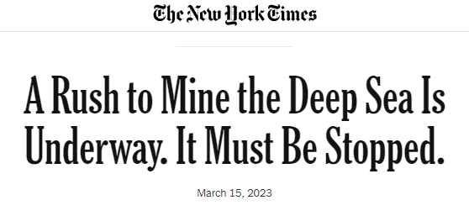
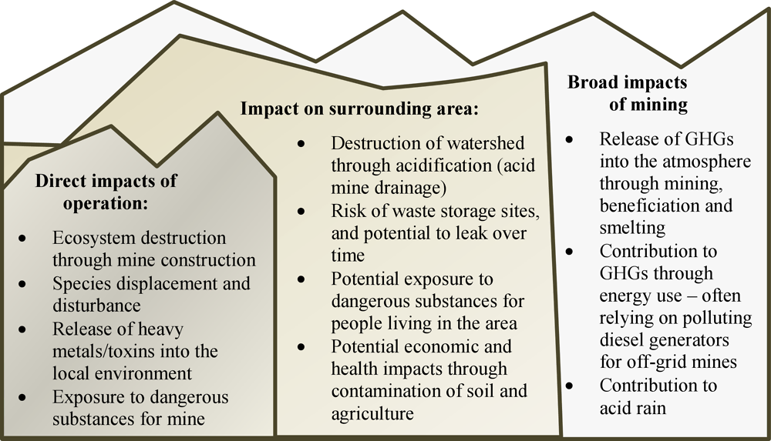
What about opening new mines?
Opening a new mine can take up to 15 years.
Successful outcomes not guaranteed.
Opposition and protests.

Slide 12
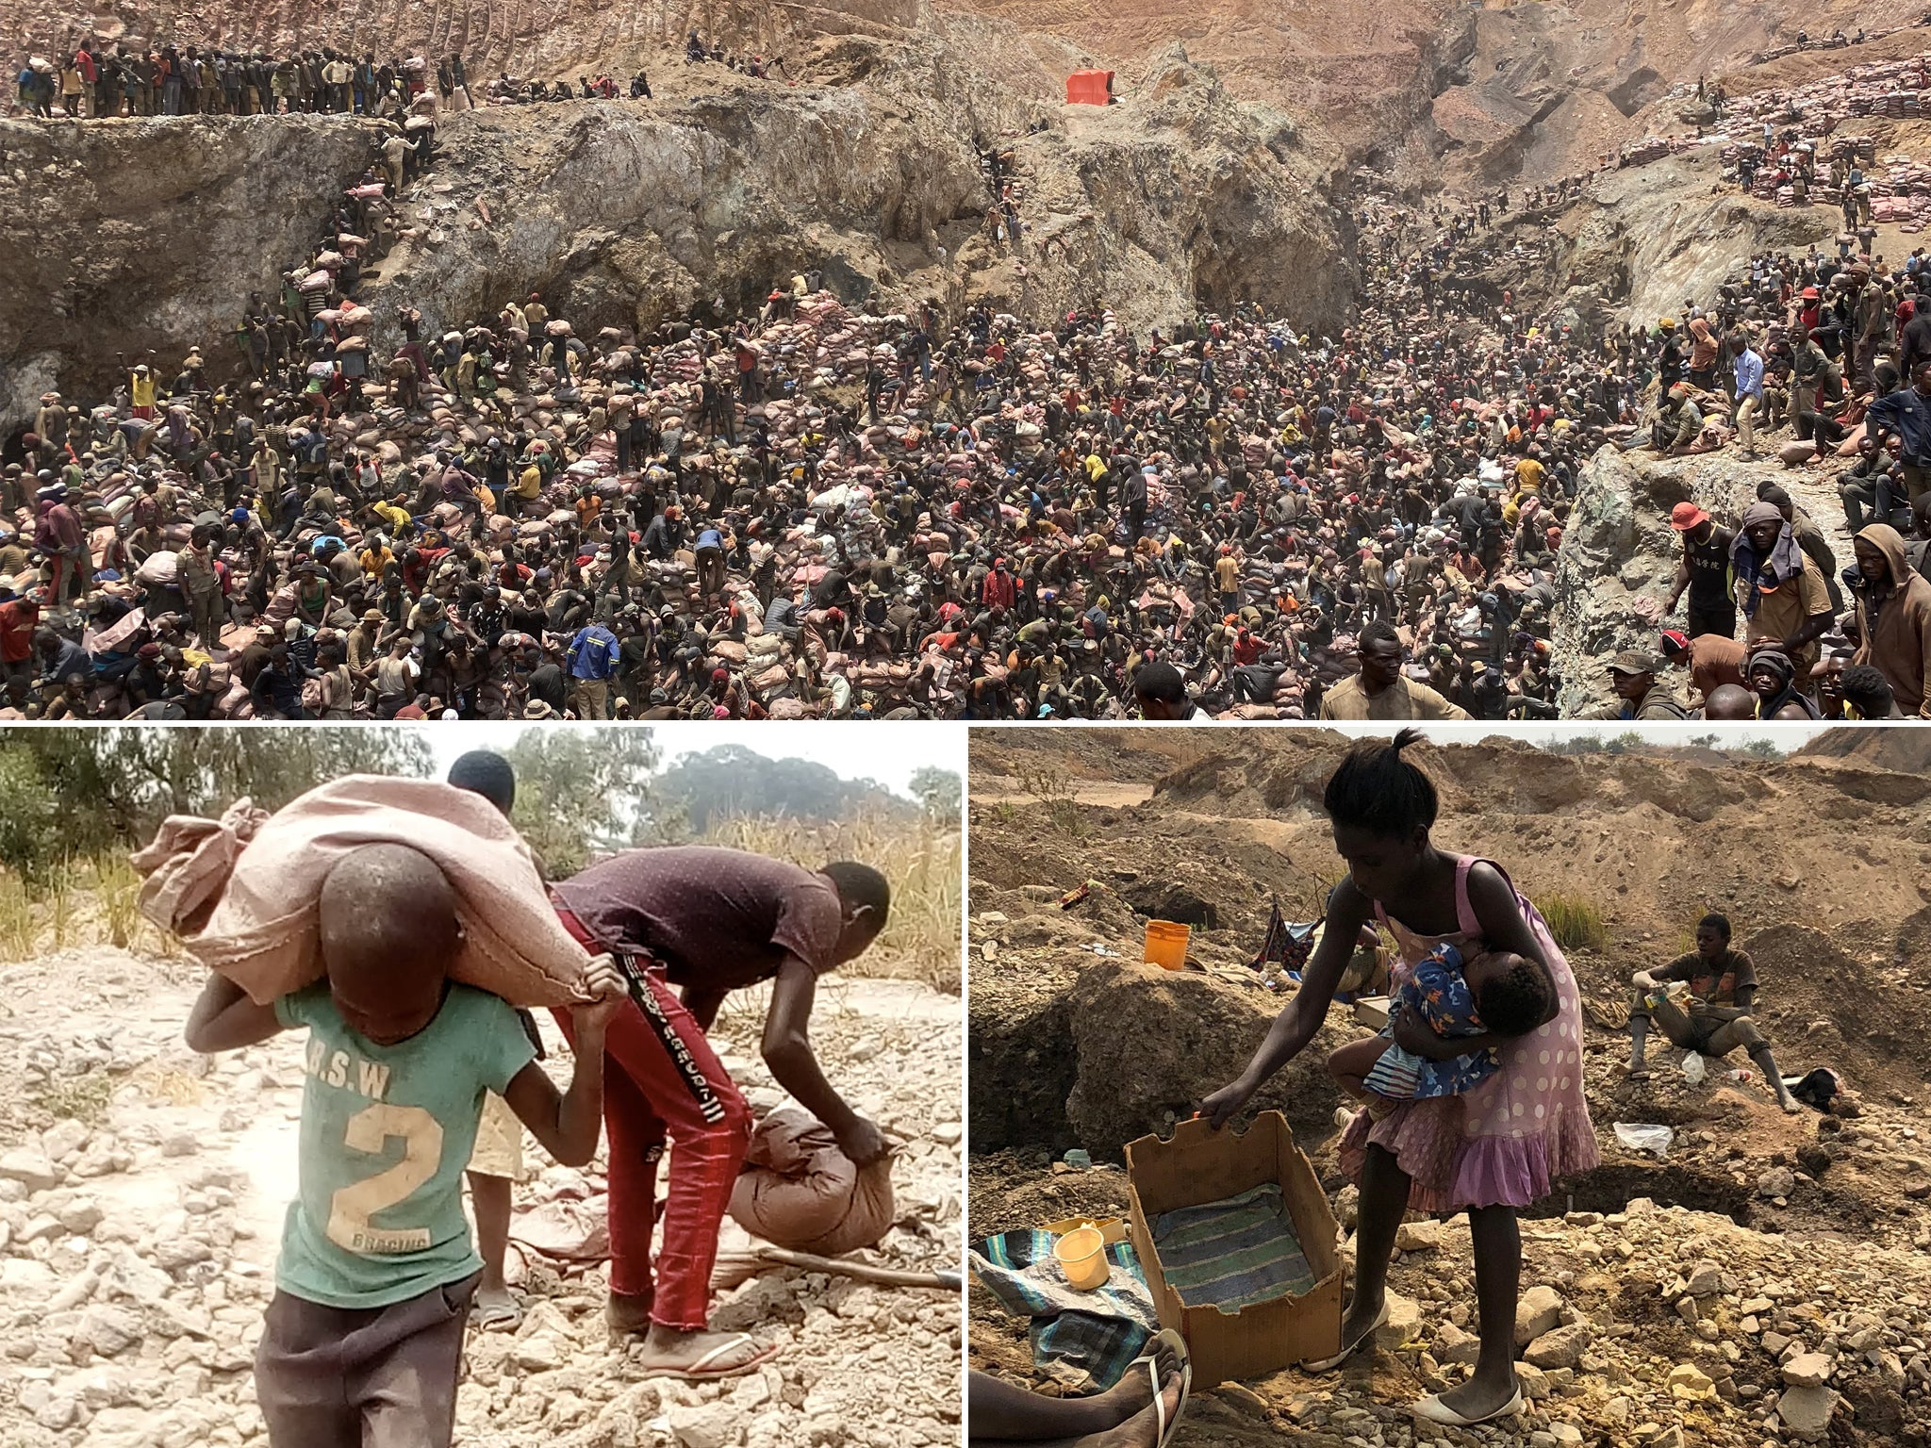
What about opening new mines?

Slide 13
Extension 1: Independent Recycler
Industry practice: Vertically integrated set-up
Ford: recycling facility in Tennessee, Renault: Refactory, 2024.
Examples: Third-party recyclers that do not manufacture
SolarCycle, US
Decoupling:
Benefits of urban mining hold, less strong due to double marginalization.
Recycler sells material to commodity market, the critical material can be lost to other industries.

Slide 14
Extension 2: What if we do BOTH Material Reduction and Urban Mining?
Two opposing effects:
Positive: Recover materials and build even more due to lower material content -> Increased revenues.
Negative: Increase urban mining cost (reduced material density), need more collection and processing
In most cases, the strategies are substitutes, not complements

Slide 15
Benchmark model
Installed base
Supply
Revenues
q_{B} units of material
= q_{B} products
= q_{B} MWh
Waste
Cost of purchasing q_{B} units

Slide 16
Material reduction model
Installed base
Supply
Waste
Cost of purchasing q_{M} units
Additional processing costs
1 unit of material -> 1+ $β$ products
Efficiency loss:
1+ $β$ products -> $1+(1−γ)β$ MWh
Trade-off
Revenues
$q_{M}$ units of material = $(1+β)q_{M}$ products = $(1+(1−γ)β)q_{M}$ MWh
Additional cost c
Convex R&D costs

Slide 17
Urban Mining model
Virgin
Supply
Installed base
Secondary
Supply
Leakage
Waste
Cost of purchasing q_{U} units
Marginal recycling costs
Recover r units of material
Fixed recycling costs
Initial investment cost α
Trade-off
Revenues:
$q_{U}+r$ units of material = $q_{U}+r$ products
= $q_{U}+r$ MWh
Convex recycling costs $c_{R}r^{2}$
Limited by EOL products:
$$r≤(1−κ)(q_{U}+r)$$

Slide 18
We consider 3 models

Slide 19
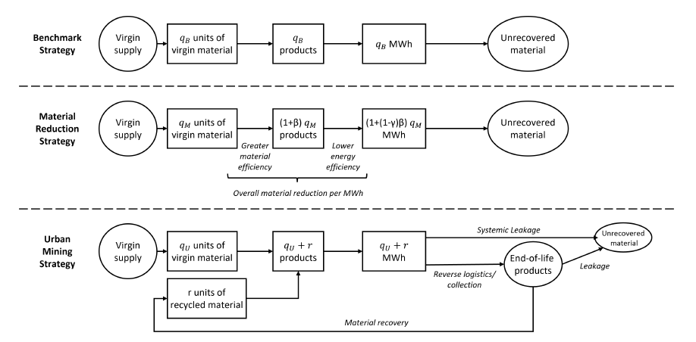
We consider 3 models: Material flows

Slide 20
Profitability and Range of Production

Slide 21
Material reduction results (1/2)
If $γ$, $ϕ$and $μ$ are below a certain threshold →
No installations when $μ≥p−c$
Reduction proportional to $(1−γ)p−c$
Otherwise →

Slide 22
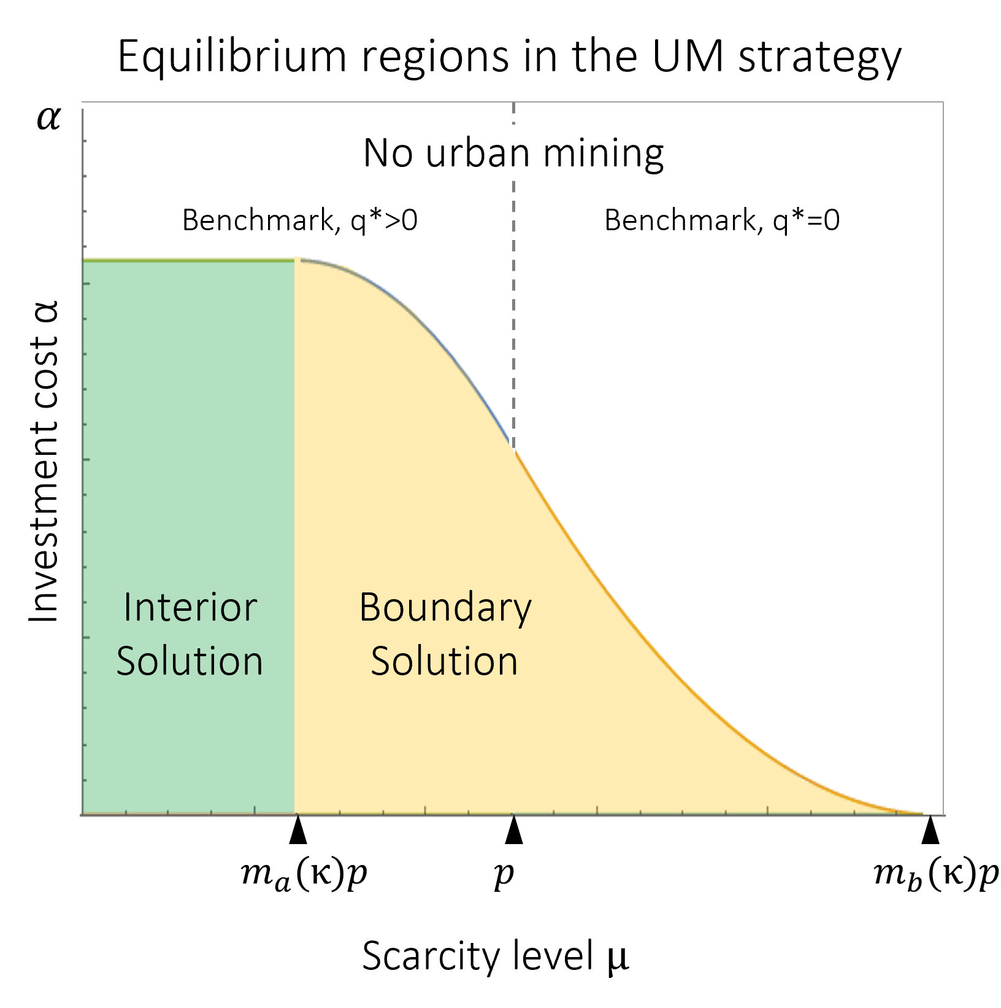
Urban Mining results (1/2)
Interior solution, when $μ<m_{a}\left(κ\right)p$ and $α<\hat{α}(κ, μ)$
Boundary solution, when $m_{b}\left(κ\right)p<μ<m_{b}\left(κ\right)p$ and $α<\hat{α}(κ, μ)$
Benchmark solution, otherwise

Slide 23
The path to the renewable energy transition
Low scarcity
High scarcity
Prob of negative profits and production range
Clean energy generation
Profits
Prob of negative profits and production range
Clean energy generation
Profits
Benchmark
Material Reduction
Urban mining
Depends on α and κ
Depends on α and κ

